Slide 1


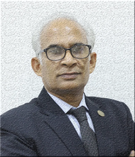
How to
Master the Art of Making a Powerful Impression in Business Meetings
Follow Shafqat Jilani
for Sales Leadership + Business Empowerment
www.IKTAR.org | info@IKTAR.org | +92 321 783 5515

Slide 2

Creating a powerful, professional aura in a business meeting is all about projecting confidence, expertise, and approachability. Here are some steps to help you make a strong impression, whether you’re meeting with one person or a group.
Follow Shafqat Jilani
for Sales Leadership + Business Empowerment
www.IKTAR.org | info@IKTAR.org | +92 321 783 5515

Slide 3

1
Prepare
Thoroughly and Know Your Material
  Goal: To show that you’re knowledgeable, reliable, and detail-oriented.
  How: Research the people you’re meeting with, understand their goals, and be clear on what you want to convey. Anticipate their questions and concerns so that you’re ready to respond confidently. This preparation will help you feel secure and in control.
Follow Shafqat Jilani
for Sales Leadership + Business Empowerment
www.IKTAR.org | info@IKTAR.org | +92 321 783 5515

Slide 4

2
Dress to Impress and Reflect Your Brand
  Goal: Present a polished and credible image that aligns with your personal and professional brand.
  How: Wear attire that is slightly more formal than expected to make a strong first impression. Make sure your clothes are well-fitted, clean, and appropriate for the setting, showing that you pay attention to details.
Follow Shafqat Jilani
for Sales Leadership + Business Empowerment
www.IKTAR.org | info@IKTAR.org | +92 321 783 5515

Slide 5

3
Use Confident
Body Language
  Goal: Communicate self-assurance and openness through your posture and gestures.
  How: Stand tall, sit with your shoulders relaxed and open, and avoid crossing your arms or fidgeting. Maintain a relaxed but confident posture. Use controlled gestures when speaking to emphasize points without overdoing it.
Follow Shafqat Jilani
for Sales Leadership + Business Empowerment
www.IKTAR.org | info@IKTAR.org | +92 321 783 5515

Slide 6

4
Establish
Strong
Eye Contact
  Goal: Build trust and show engagement.
  How: When addressing a group, make eye contact with each person, giving everyone a few seconds of direct attention. If it’s a one-on-one meeting, maintain eye contact without staring, showing you’re actively engaged in the conversation.
Follow Shafqat Jilani
for Sales Leadership + Business Empowerment
www.IKTAR.org | info@IKTAR.org | +92 321 783 5515

Slide 7
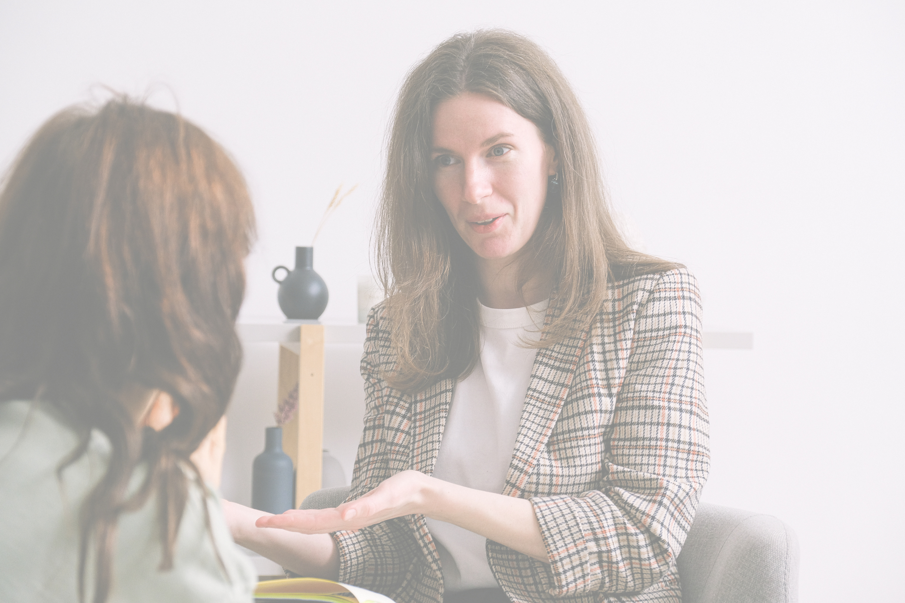
5
Listen Attentively and
Speak with Clarity
  Goal: Convey respect for others’ opinions and communicate your ideas effectively.
  How: Let the other person speak fully before responding, and avoid interrupting. Show you’re actively listening by nodding and responding to key points. When you speak, be clear, concise, and avoid filler words. A calm, clear voice with moderate pacing can convey confidence and authority.
Follow Shafqat Jilani
for Sales Leadership + Business Empowerment
www.IKTAR.org | info@IKTAR.org | +92 321 783 5515

Slide 8

6
Demonstrate Empathy and Respectful Assertiveness
  Goal: To show that you’re knowledgeabBuild rapport while staying professional.
  How: Show you understand others’ perspectives by acknowledging their points before presenting your own. Avoid being overly assertive, but speak up for your ideas confidently. This balance of empathy and assertiveness will project strength without coming across as aggressive.
Follow Shafqat Jilani
for Sales Leadership + Business Empowerment
www.IKTAR.org | info@IKTAR.org | +92 321 783 5515

Slide 9

7
Ask Insightful Questions
  Goal: Show your expertise and genuine interest in the conversation.
  How: Prepare a few thoughtful questions that reflect your understanding of the topic and the person’s needs or goals. Asking relevant questions can position you as both knowledgeable and genuinely invested in the outcomes.
Follow Shafqat Jilani
for Sales Leadership + Business Empowerment
www.IKTAR.org | info@IKTAR.org | +92 321 783 5515

Slide 10

8
End with a Strong Conclusion and Follow-Up Plan
  Goal: Leave a lasting, positive impression with a clear next step.
  How: Summarize key points, reaffirm any commitments or next steps, and thank the person or group for their time. After the meeting, follow up promptly with any promised information or materials, reinforcing your reliability and attention to detail.
Follow Shafqat Jilani
for Sales Leadership + Business Empowerment
www.IKTAR.org | info@IKTAR.org | +92 321 783 5515

Slide 11

9
Be Aware
of
Your Energy
  Goal: Convey positive energy that is both calm and engaged.
  How: Keep your energy steady, avoid nervous gestures, and project warmth and enthusiasm. A composed energy can help you appear in control, while an approachable attitude makes you someone people want to engage with.
Follow Shafqat Jilani
for Sales Leadership + Business Empowerment
www.IKTAR.org | info@IKTAR.org | +92 321 783 5515

Slide 12

10
Take Time for Reflection After Each Meeting
  Goal: Continuously improve your professional presence.
  How: After each meeting, reflect on what went well and where you can improve. Consider your body language, engagement level, and clarity. This practice will allow you to polish your approach for future meetings.
Follow Shafqat Jilani
for Sales Leadership + Business Empowerment
www.IKTAR.org | info@IKTAR.org | +92 321 783 5515

Slide 13

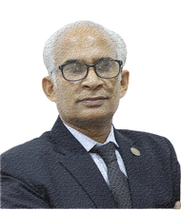
"Transform Insight
into Action"
Success isn't about knowing the rules, it's about applying them effectively.
Are you ready to elevate your business and personal growth?
Let's connect and unlock your true potential.
📧 info@IKTAR.org
🌐 IKTAR.org
📱 +92 321 783 5515
Follow Shafqat Jilani
for Sales Leadership + Business Empowerment
www.IKTAR.org | info@IKTAR.org | +92 321 783 5515

